Slide 1
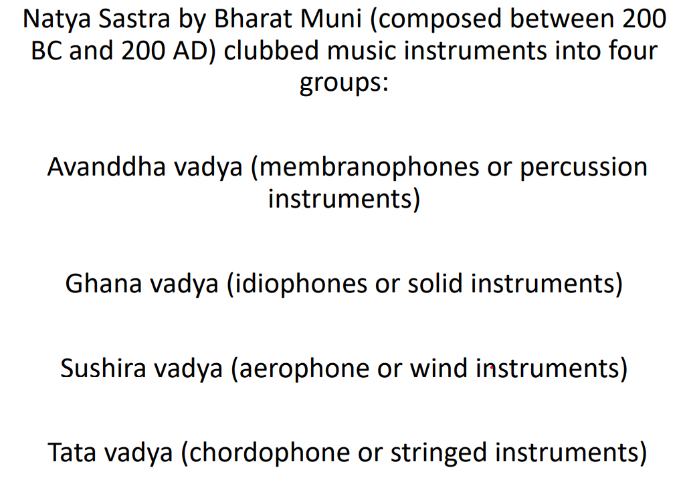

Slide 2
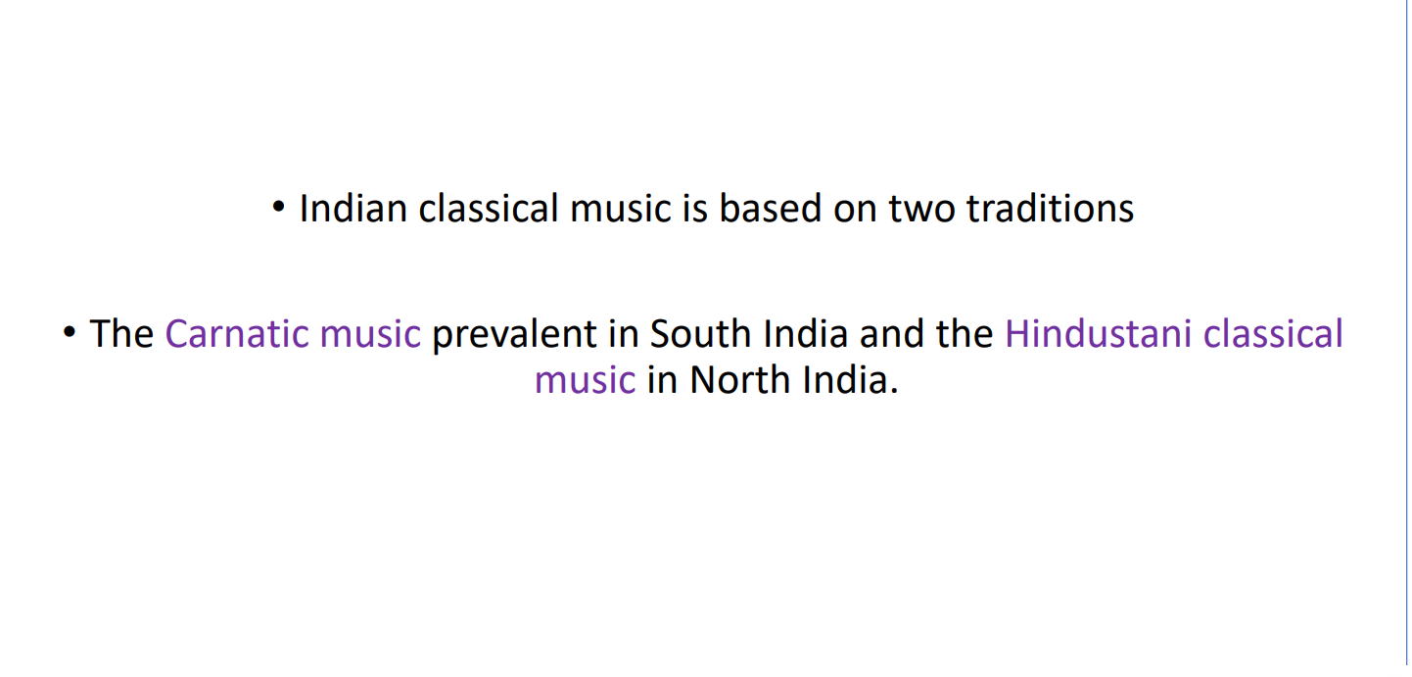

Slide 3
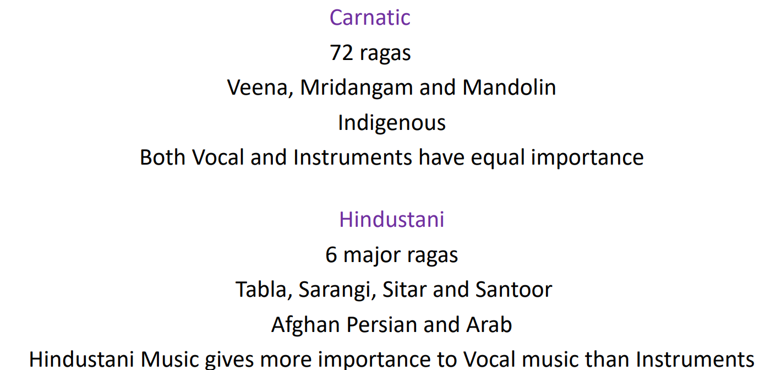

Slide 4
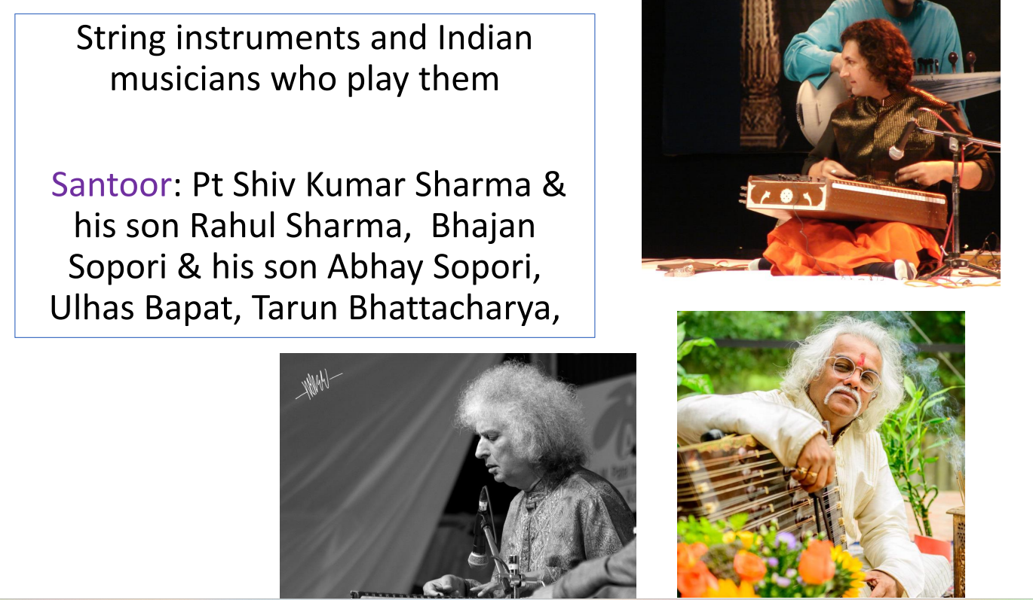

Slide 5
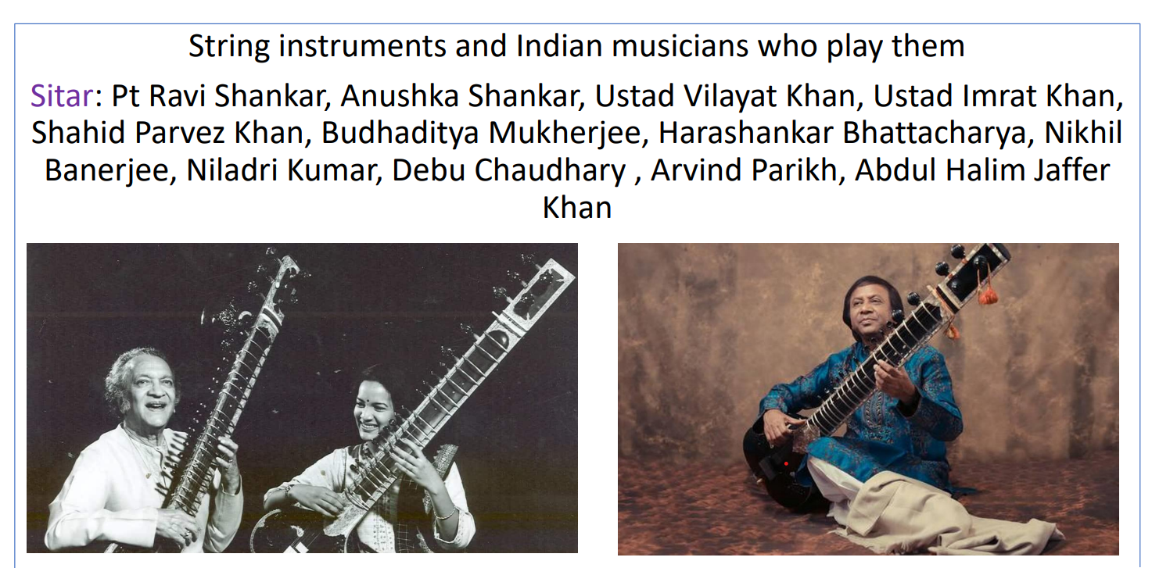

Slide 6
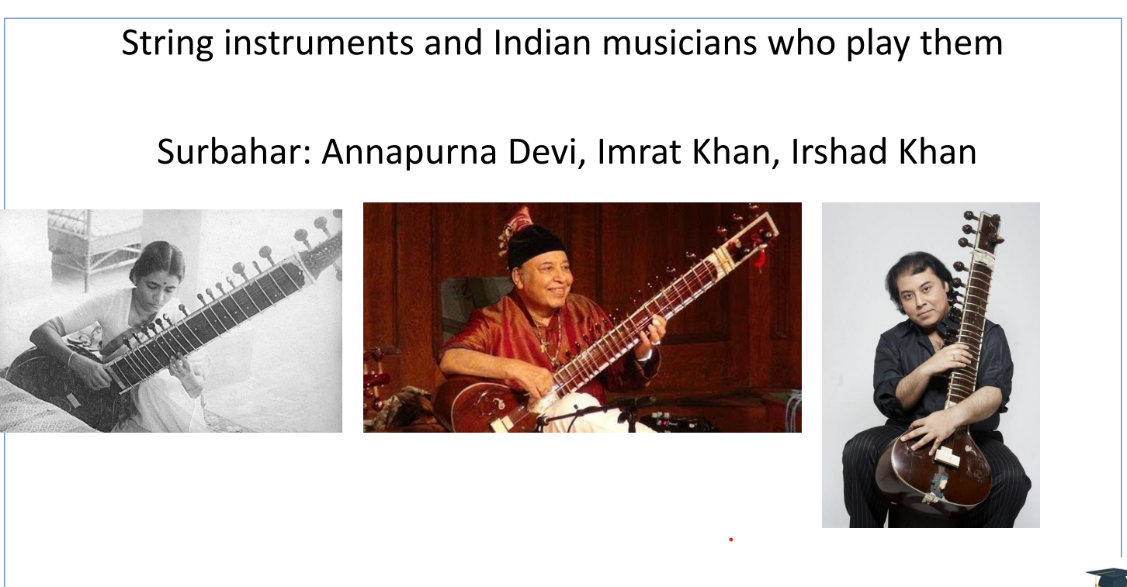

Slide 7
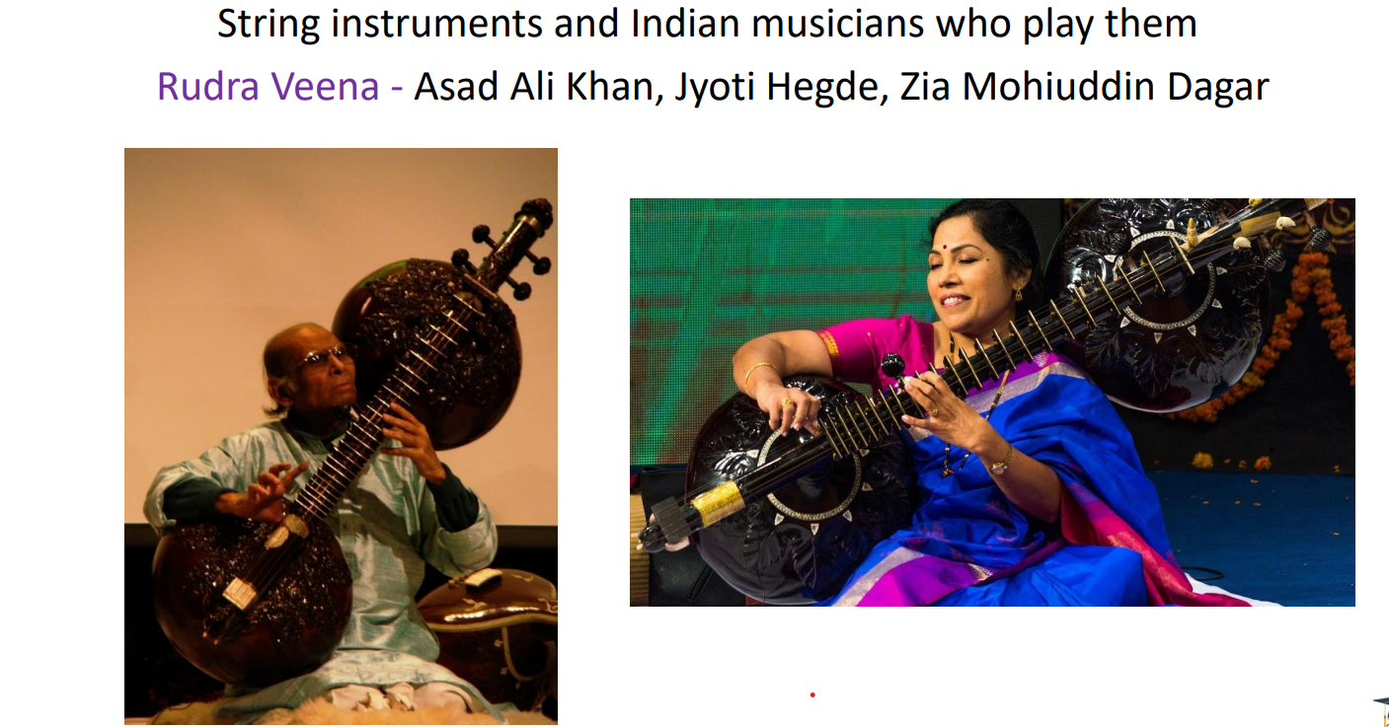

Slide 8
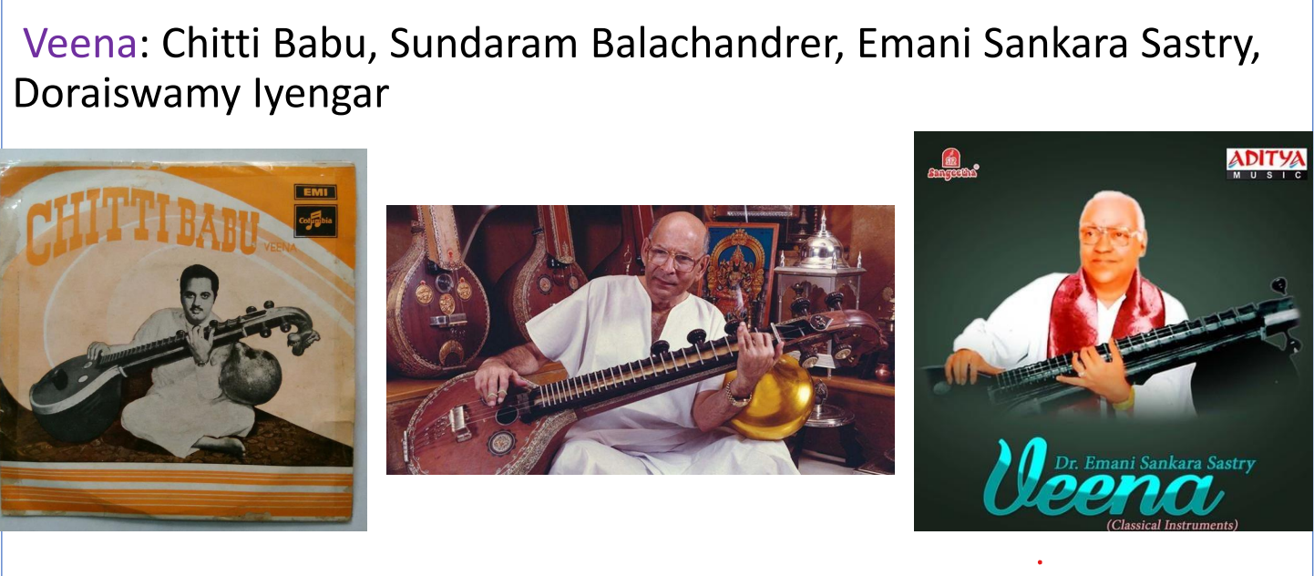

Slide 9
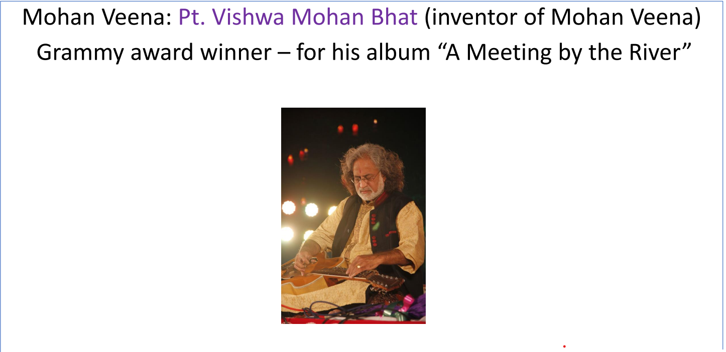

Slide 10
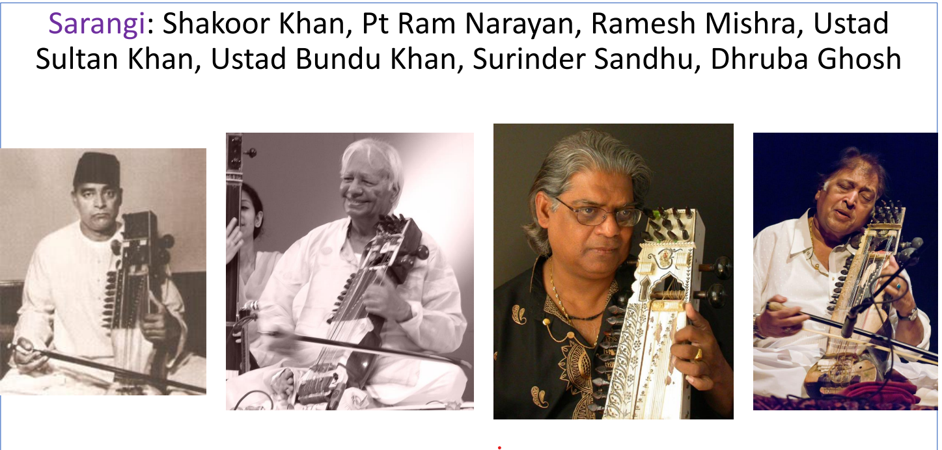

Slide 11
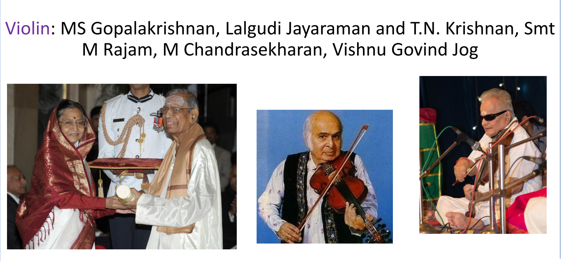

Slide 12
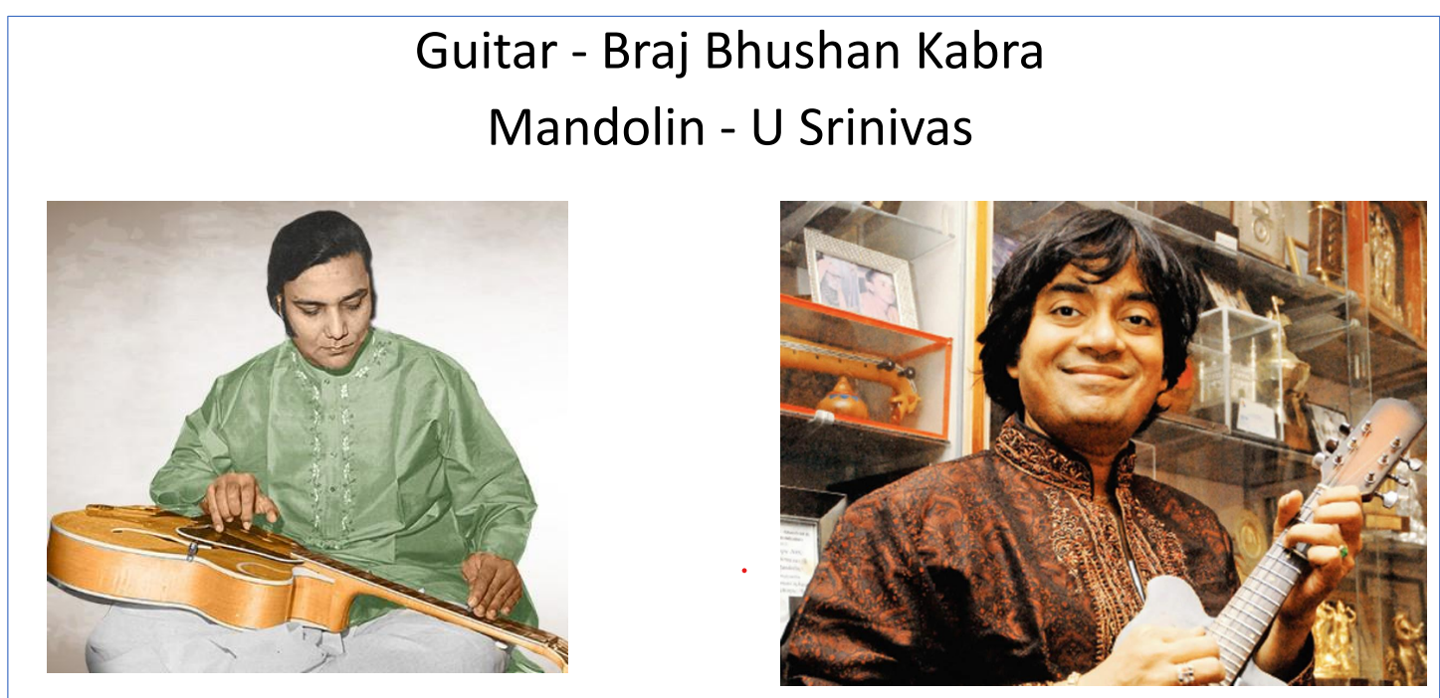

Slide 13
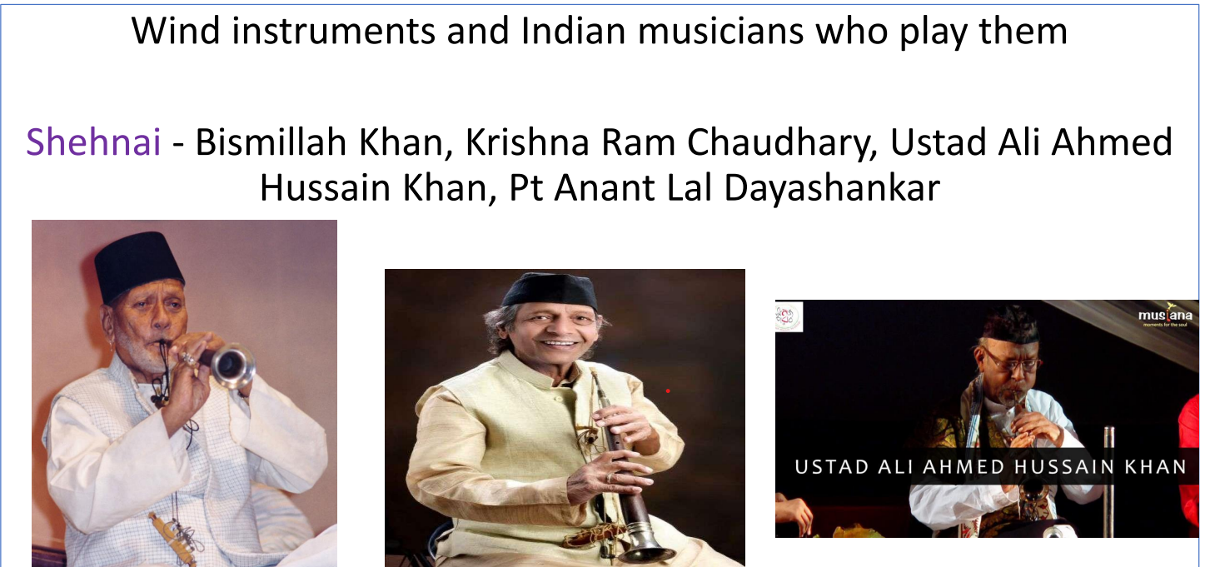

Slide 14
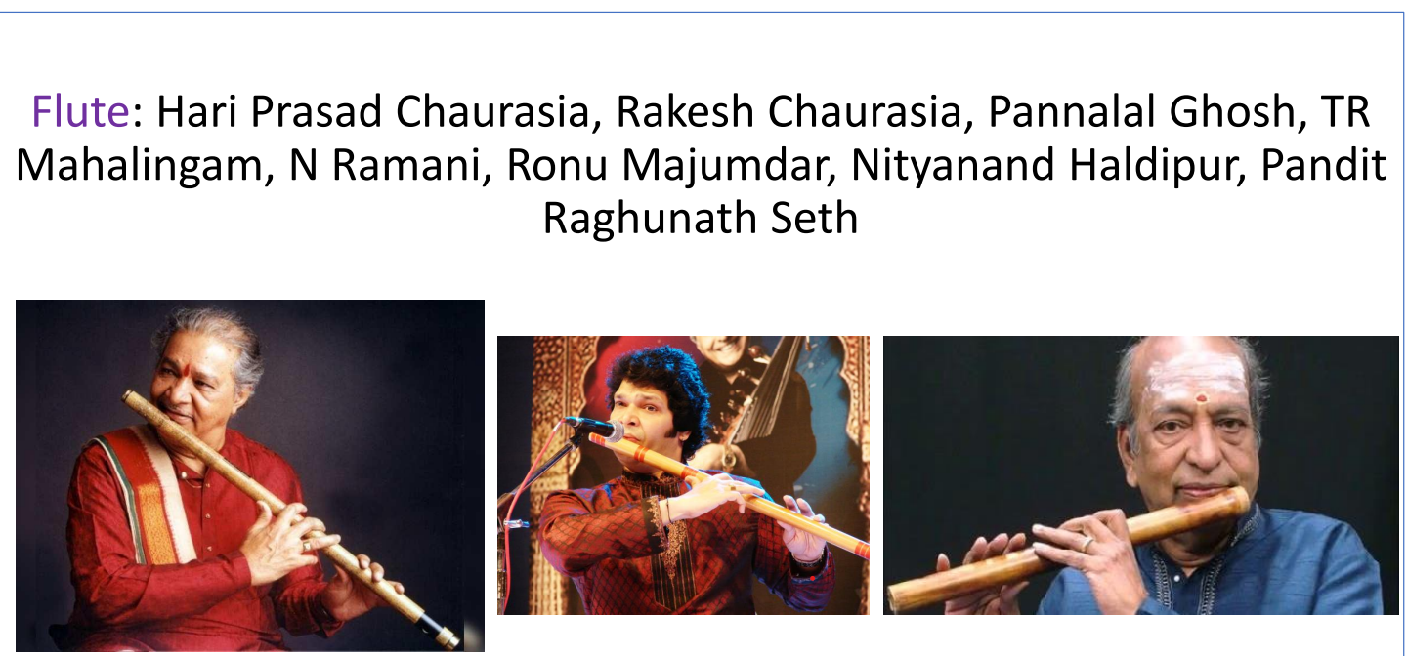

Slide 15
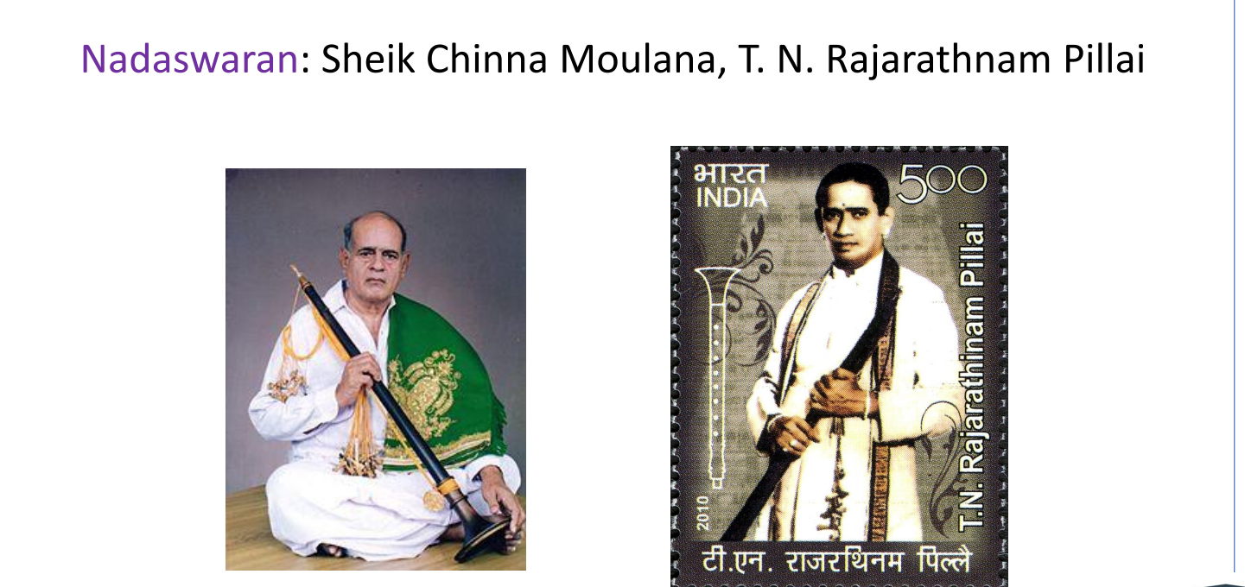

Slide 16
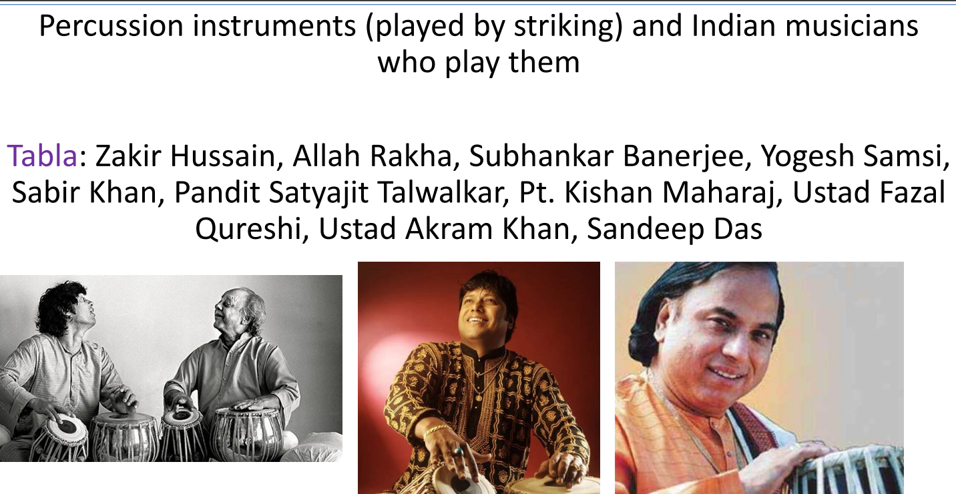

Slide 17
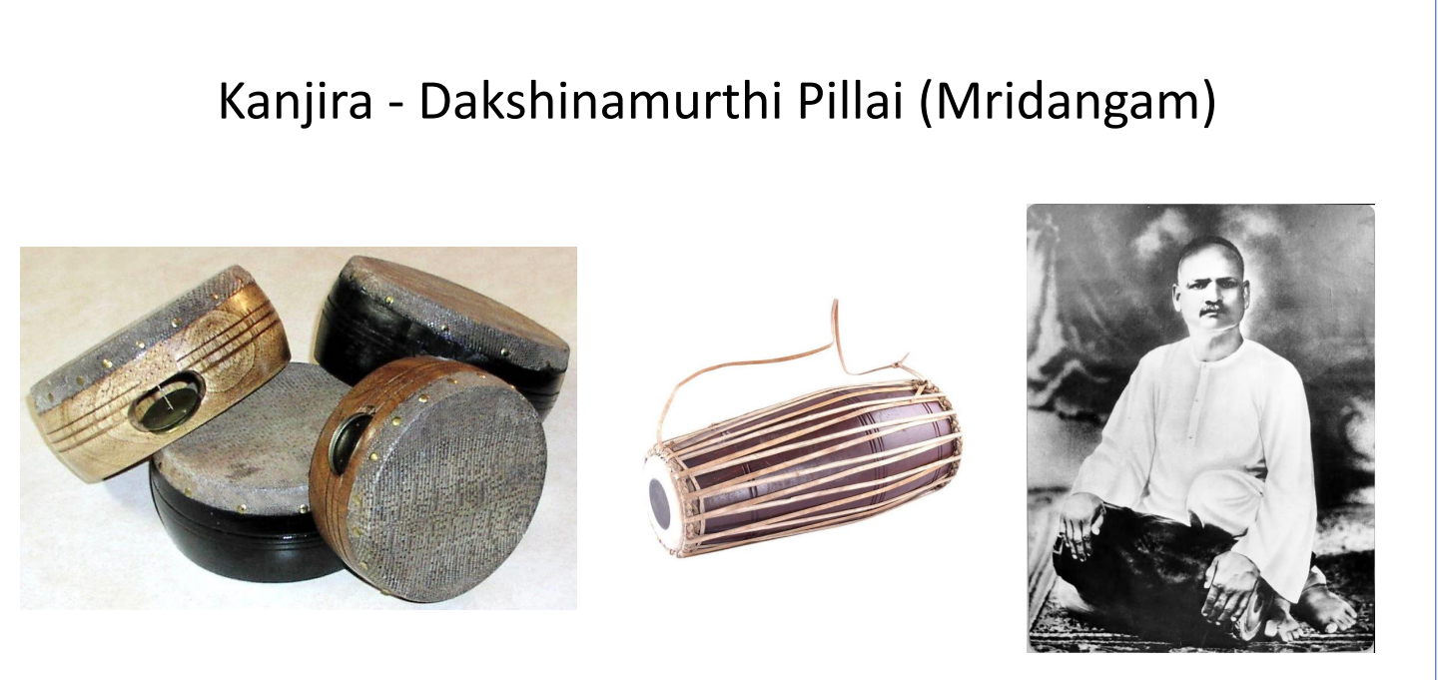

Slide 18
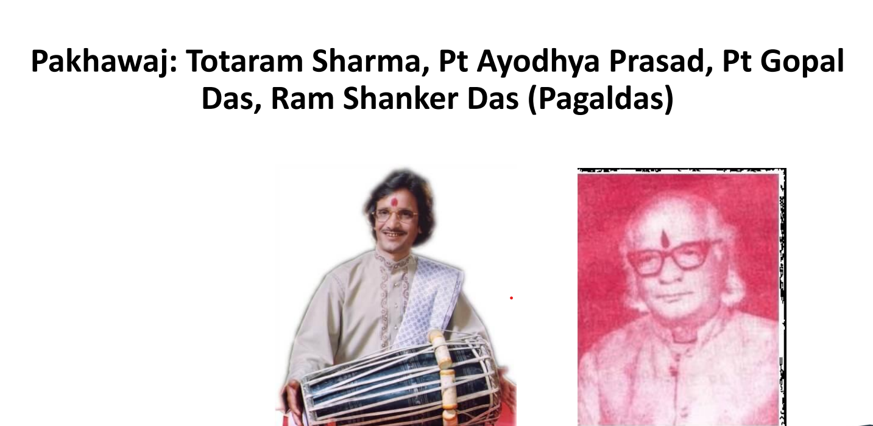

Slide 19
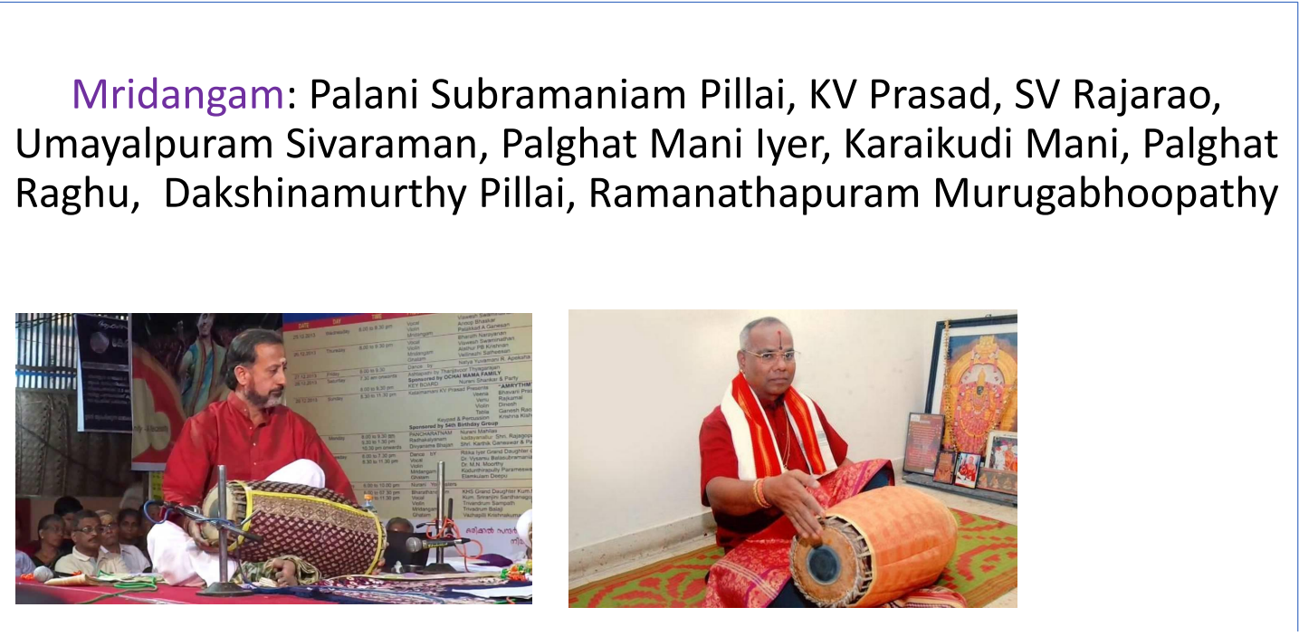

Slide 20
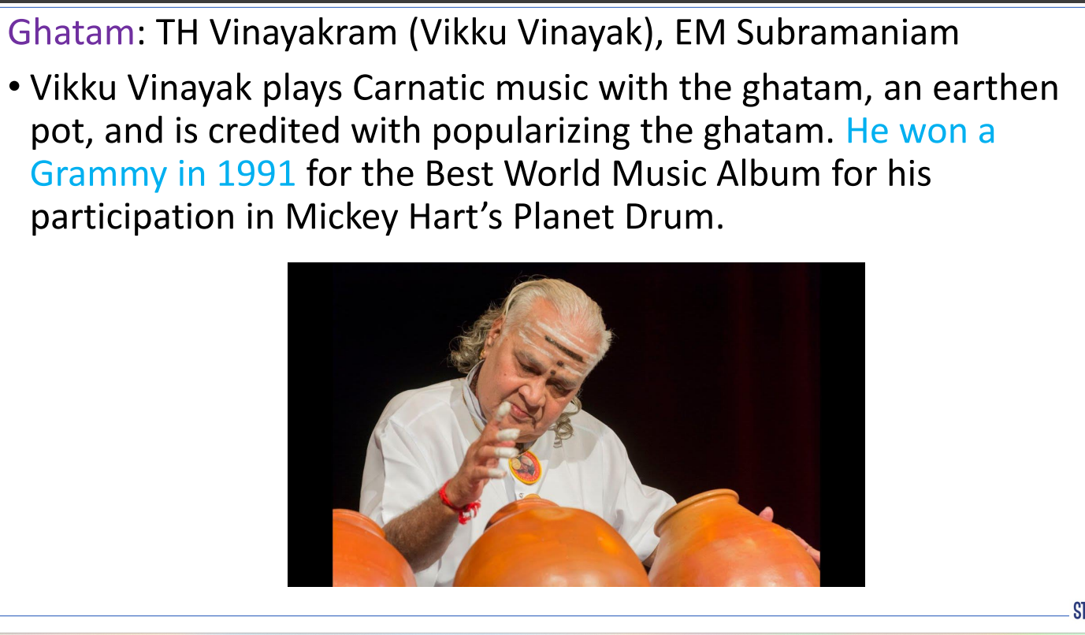

Slide 21
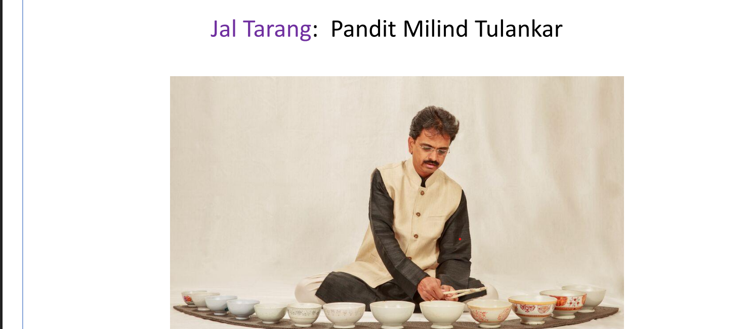

Slide 22
Who is credited with creating the world famous Raaga Miya ki Malhar?

Slide 23
TANSEN

Slide 24
The oldest form of composition of Hindustani Vocal Music is:

Slide 25
DHRUPAD

Slide 26
Which stringed instrument has the most number of strings?

Slide 27
SITAR

Slide 28
In which of the following is the theory of classical music discussed?

Slide 29
SAMA VEDA

Slide 30
Who of the following is referred to as the Parrot of India?

Slide 31
AMIR KHUSRAO

Slide 32
Who of the following composed Raga Kameshwari?

Slide 33
PANDIT RAVI SHANKAR

Slide 34
The lowest range of musical note is referred to as -

Slide 35
BASS

Slide 36
Who was the first person associated with classical music to be awarded the Bharat Ratna?

Slide 37
M S SUBHALAKSHMI

Slide 38
On which of the following raagas is the National Song, Vande Mataram usually sung?

Slide 39
RAAG DESH

Slide 40
Which institution awards the Sangeet Kalanidhi Award to a Carnatic musician every year?

Slide 41
MUSIC ACADEMY CHENNAI

Slide 42
Dungchen is a musical instruments associated with which of the following religions?

Slide 43
BUDDHISM

Slide 44
Which of the following is used mainly in the military where it is blown to indicate the daily routines of the camp?

Slide 45
BUGLE

Slide 46
Which of the following is usually used as a drone instrument that is to provide a constant pitch background?

Slide 47
TANPURA

Slide 48
Which of the following instruments has been traditionally used in Carnatic music?

Slide 49
MRIDANGAM

Slide 50
What name is given to the unmetered opening section of a classical singing performance?

Slide 51
ALAAP

Slide 52
Which of the following is an early morning raaga?

Slide 53
Raag bhairav

Slide 54
Who of the following is considered the founder of the Indore Gharana of Hindustani classical music?

Slide 55
Amir khan

Slide 56
Who of the following was the first Indian associated with classical music to be awarded the Ramon Magsaysay Award?

Slide 57
M s subhalakshmi

Slide 58
Who of the following composed music for the famous Bengali film Kabuliwala based on a story by Rabindranath Tagore and directed by Tapan Sinha?

Slide 59
Ravi shankar

Slide 60
What kind of musical instruments are mentioned as Avanaddha Vadya in the Natya Shastra?

Slide 61
PERCUSSION INSTRUMENTS

Slide 62
Who is the only Indian to be awarded the Grammy Lifetime Achievement Award?

Slide 63
RAVI SHANKAR

Slide 64
With which of the following Gharanas was Pandit Bhimsen Joshi associated?

Slide 65
KIRANA GARANA

Slide 66
Who was the first Indian to win a Grammy Award?

Slide 67
RAVI SHANKAR

Slide 68
Which of the following musical instruments is commonly known as mouth organ?

Slide 69
HARMONICA

Slide 70
Who of the following is acclaimed as India's first female professional tabla player?

Slide 71
ANURADHA PAL

